Slide 1
Mastering Blockchain Third Edition
Chapter 12, Further Ethereum

Slide 2
Outline
Blocks and the blockchain
Wallets and client software
Nodes and miners
APIs and tools
Supporting protocols
Programming languages

Slide 3
Blocks and the blockchain
An Ethereum block consists of several fields, shown in the diagram to the right.
State root, transaction root and receipts root are root hashes of their respective tries.

Slide 4
The block validation mechanism
The Ethereum block validation mechanism checks the following conditions:
If it is consistent with uncles and transactions. This means that all ommers satisfy the property that they are indeed uncles, and also if the Proof of Work (PoW) for uncles is valid.
If the previous block (parent) exists and is valid.
If the timestamp of the block is valid. This means that the current block's timestamp must be higher than the parent block's timestamp. Also, it should be less than 15 minutes into the future. All block times are calculated in epoch time (Unix time).
If any of these checks fails, the block will be rejected. A list of errors for which the block can be rejected is presented here:
The timestamp is older than the parent
There are too many, or duplicate uncles
The uncle is an ancestor, or the uncle’s parent is not an ancestor
There is non-positive difficulty
There is an invalid mix digest or PoW

Slide 5
Block finalization
Block finalization is a process that is run by miners to validate the contents of the block and apply rewards. It results in four steps being executed. These steps are described here:
Ommers (uncles) validation. In the case of mining, determine ommers. The validation process of the headers of stale blocks checks whether the header is valid and whether the relationship between the uncle and the current block satisfies the maximum depth of six blocks. A block can contain a maximum of two uncles.
Transaction validation. In the case of mining, determine transactions. This process involves checking whether the total gas used in the block is equal to the final gas consumption after the final transaction, in other words, the cumulative gas used by the transactions included in the block.
Reward application. Apply rewards, which means updating the beneficiary's account with a reward balance. In Ethereum, a reward is also given to miners for stale blocks, which is 1/32 of the block reward. Uncles that are included in the blocks also receive 7/8 of the total block reward. The current block reward is 2 ether. It was reduced first from 5 ether to 3 with the Byzantium release of Ethereum. Later, in the Constantinople release (https://blog.ethereum.org/2019/02/22/ethereum-constantinople-st-petersburg-upgrade-announcement/), it was reduced further to 2 ether. A block can have a maximum of two uncles.
State and nonce validation. Verify the state and block nonce. In the case of mining, compute a valid state and block nonce.

Slide 6
Block difficulty mechanism
The block difficulty mechanism is represented by the formula below, which ensures that blocks are produced at a constant rate:
block_diff = parent_diff + parent_diff // 2048 *
max(1 - (block_timestamp - parent_timestamp) // 10, -99) +
int(2**((block.number // 100000) - 2))
The gas cost of a transaction can be calculated using this formula:
Total cost = gasUsed * gasPrice

Slide 7
Wallets and client software
Wallets
Light clients
There are three client synchronization types:
Full: In this synchronization mode, the Geth client downloads the complete blockchain to its local node. This means that it gets all the block headers and block bodies and validates all transaction and blocks since the genesis block. As of early 2020, the Ethereum blockchain size is roughly 210 GB, and downloading and maintaining that could be a problem. Usually, SSDs are recommended for a full node, so that disk latency cannot cause any processing delays.
Fast: The client downloads the full blockchain, but it retrieves and verifies only the previous 64 blocks from the current block. After this, it verifies the new blocks in full. It does not replay and verify all historic transactions since the genesis block; instead it only does the state downloads. This also reduces the on-disc size of the blockchain database quite significantly. This is the default mode of Geth client synchronization.
Light: This is the quickest mode and only downloads and stores the current state trie. In this mode, the client does not download any historic blocks and only processes newer blocks.

Slide 8
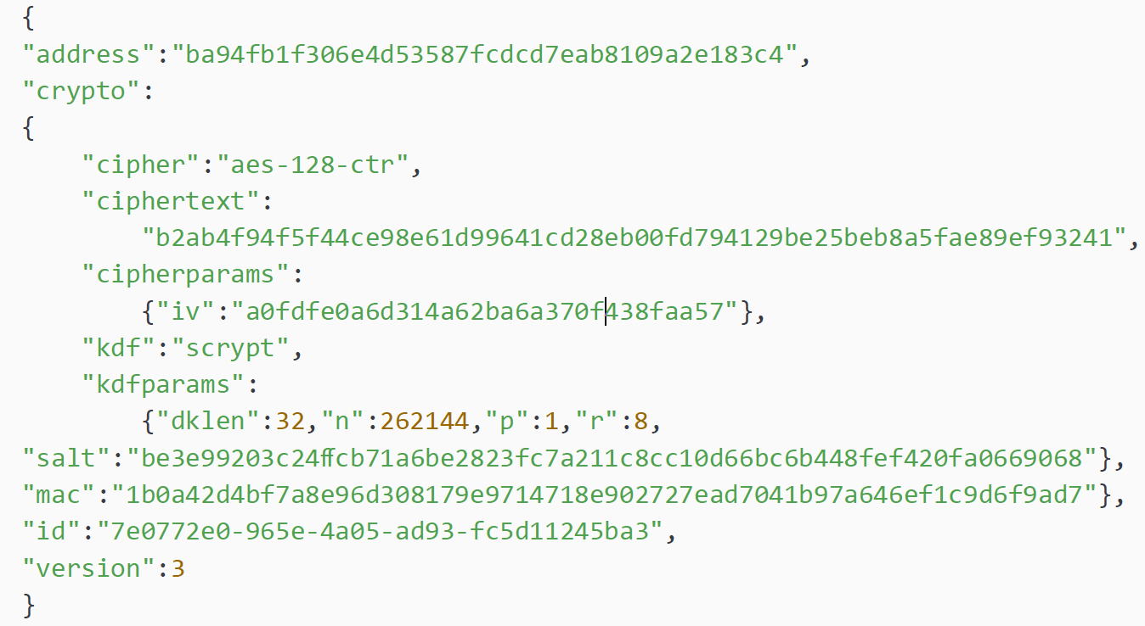
Ethereum keystore
Key decryption process
Public and private key files are stored in the keystore directory. The Ethereum keystore files are JSON files, the contents of which looks something like the script below

Slide 9
MetaMask
MetaMask is a cryptocurrency wallet and an interface to blockchain networks without requiring local node installation.

Slide 10
Nodes and miners
Mining is the process by which new blocks are selected via a consensus mechanism and added to the blockchain. The process takes the following steps:
It listens for the transactions broadcasted on the Ethereum network and determines the transactions to be processed.
It determines stale ommer blocks and includes them in the blockchain.
It updates the account balance with the reward earned from successfully mining the block.
Finally, a valid state is computed and the block is finalized, which defines the result of all state transitions.

Slide 11
Ethash
Ethash is the name of the Proof of Work algorithm used in Ethereum.
First, the header from the previous block and a 32-bit random nonce is combined using Keccak-256.
This produces a 128-bit structure called mix.
mix determines which data is to be picked up from the DAG.
Once the data is fetched from the DAG, it is "mixed" with the mix to produce the next mix, which is then again used to fetch data from the DAG and subsequently mixed. This process is repeated 64 times.
Eventually, the 64th mix is run through a digest function to produce a 32-byte sequence.
This sequence is compared with the difficulty target. If it is less than the difficulty target, the nonce is valid, and the PoW is solved. As a result, the block is mined. If not, then the algorithm repeats with a new nonce.

Slide 12
Mining
CPU
Mining using a computer’s built in CPU
GPU
Mining using graphical processing units, which provide better performance as compared to CPUs
ASICs
Specialized hardware—Application-Specific Integrated Circuit designed solely to run mining algorithms. These are currently the most efficient mining tools
Mining pools
In mining pools, resources are shared between miners and rewards are split accordingly

Slide 13
Supporting protocols
Two main supporting protocols, Swarm and Whisper, are used to provide decentralized storage and messaging, in order to create a complete decentralized ecosystem.

Slide 14
Programming languages
Solidity is one of the high-level languages that has been developed for Ethereum. It uses JavaScript-like syntax to write code for smart contracts. Once the code is written, it is compiled into bytecode that's understandable by the EVM using the Solidity compiler called solc.
LLL is another language that is used to write smart contract code.
Serpent is a Python-like, high-level language that can be used to write smart contracts for Ethereum.
Vyper is a newer language that has been developed from scratch to achieve a secure, simple, and auditable language.

Slide 15
Exercise
Install Geth and run it on the Kovan testnet.

Slide 16
Summary
In this presentation, we explored:
Blocks and blockchain
Wallets and client software
Nodes and miners
APIs and tools
Supporting protocols
Programming languages

